Slide 1
High Dynamic Range Imaging(HDR)
Group No 5
Team:
Sarwan ali (16030030)
Moeen Ud Din (15030008)
Bilal Rabbani (15030017)
Supervisor : Dr. Nadeem Ahmad Khan

Slide 2
Outline
Introduction
Goal
Literature Review
Experiments
References

Slide 3
Analysis of different tone mapping operators for high dynamic range images

Slide 4
1. INTRODUCTION

Slide 5
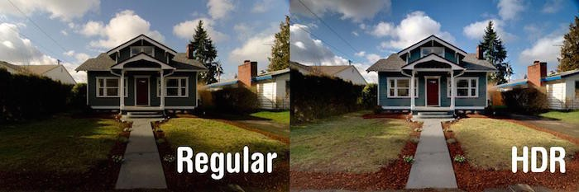
What is HDR?
Taking images at various exposures and combining them into one image.
The purpose is to get a better quality image with more details in the picture.
*http://www.citymac.com/blog/2015/07/01/how-to-take-better-photos-on-iphone

Slide 6
What is tone mapping?
Tone mapping is a technique that is used to convert high range to low range.
This is required because most display devices can only reproduce low dynamic range values.
To keep the image as real as possible and to fit it onto the display device Tone mapping is used.

Slide 7
What are tone mapping operators?
Tone mapping operators are used to map high range of dynamic values to a lower range of dynamic values.
There are several kinds of tone mapping operators, but generally can be classified into 2 categories
Local
Global

Slide 8
Local Tone mapping
Local tone mapping consider pixel neighborhood information in the mapping processing for each individual pixel, which simulates the adaptive and local property of human vision system.
Thus, Local tone mapping technologies can achieve much better results then global.
However, this will take longer for your computer to process.
Local tone mapping is used to prepare the final results for display or printing

Slide 9
Global Tone mapping
Global tone mapping refer to techniques that use a monotonic (uniformity) mapping curve to independently transfer real-world lighting and color to your display.
These technologies are relatively simple and fast.
However, these technologies cannot give impressive results
Global tone mapping technologies are usually used for fast preview of images

Slide 10
2. GOAL

Slide 11
GOAL
Different researchers have proposed different kind of tone mapping operators.
Our goal is to identify the best suited tone mapping operator by comparing some of the state of the art tone mapping operators.
Two ways to visualize images in low dynamic range (LDR)
Computational Structure for tone mapping operators
Comparing different low quality HDR images

Slide 12
Quality Assessment Techniques
Two kinds of Quality Assessment Techniques:
Subjective Evaluation
Objective Evaluation

Slide 13
Subjective Evaluation
This is a simple technique done by visualizing an image by the human eye.

Slide 14
Objective Evaluation
There are multiple objective image quality measures.
Speak signal-to-noise ratio (PSNR)
Structural similarity index (SSIM)

Slide 15
Objective Evaluation
Since the original HDR and the tone mapped LDR images have different dynamic ranges, therefore typical objective image quality measures are not applicable.

Slide 16
Objective Evaluation
Solution??

Slide 17
Objective Evaluation
Several objective assessment methods have been proposed for HDR images.
HDR visible differences predictor (HDR-VDP)
Dynamic range independent quality measure

Slide 18
Objective Evaluation
We will use ‘Dynamic range independent quality measure’ because it is based on multiple factors which will help us in assessment. Those factors are:
Loss of visible features
Amplification of invisible features
Reversal of contrast polarity

Slide 19
3. Literature Review

Slide 20
Literature Review
We have studied several research papers
High dynamic range image and video compression-fidelity matching human visual performance.[1]
Survey On Various Image Contrast Enhancement Techniques.[2]
High dynamic range image tone mapping by maximizing a structural fidelity measure. [3]
High dynamic range image compression by optimizing tone mapped image quality index. [4]
Local and global tone mapping operators in HDR image processing with amalgam technique.[5]

Slide 21
I) High dynamic range image and video compression-fidelity matching human visual performance
HDR image and video formats are designed to encode all luminance levels that can be found in the real world
They may vary from as low as 10^{-5*} cd/m^{2**} to 10^{10***} cd/m²
HDR formats can usually store contrast 1:10¹⁵ or dynamic range of 15 log₁₀ units,
While standard formats usually do not exceed the dynamic range of 3 log₁₀ units.
The maximum luminance of a typical cathode ray tube (CRT) display is 100-cd/m^{2.}
*It is roughly the luminance of moonless sky
**candela per square meter cd/m² is the derived SI unit of luminance
***It exceeds the luminance of the sun (1.6 x 10⁹ cd/m^{2 “}luminance of the sun”)

Slide 22
II) Survey On Various Image Contrast Enhancement Techniques
This paper show that a study of different picture differentiate improvement strategies has been finished.
Shading picture upgrade assumes a critical part in computerized picture preparing.
Differentiate improvement is an advancement issue and is accomplished for the pictures which are encountering low quality.
Low quality of pictures is because of different components like natural lighting conditions, abandons in photographic gadgets, and so on.
Thusly picture differentiate upgrade is imperative so as to enhance the human acknowledgment rate.

Slide 23
II) Survey On Various Image Contrast Enhancement Techniques (Continue)
The vast majority of the papers depend on histogram evening out procedure and its augmentations.
Histogram leveling is a complexity upgrade strategy in light of the histogram of the picture.
Every procedure has got its own points of interest and in addition disservices.
Different complexity upgrade strategies have been proposed by various creators as an augmentation of the customary histogram balance.
They are power obliged differentiate upgrade, dynamic range pressure, shading model change, gamma redress and channel division techniques.

Slide 24
II) Survey On Various Image Contrast Enhancement Techniques (Continue)
A few late papers are being studied under every method.
The distinctive complexity upgrade systems were examined.
Other than differentiation upgrade control requirements are likewise considered. Control sparing is a vital calculate the sight and sound gadgets.
The significant issue confronted by a large portion of the pictures is clamor.
Different methods have been analyzed for the picture commotion (noisy disturbance) decrease.
Shading model changes are essential when the handling of RGB pictures is dreary.
The vast majority of the strategies are the augmentations of the conventional histogram balance

Slide 25
III) High dynamic range image tone mapping by maximizing a structural fidelity measure
In this paper, a tone mapping approach is proposed in which search is carried out in the space of images to find better quality images in terms of a recent objective measure instead of explicitly designing a new computational structure for Tone mapping operators (TMOs).
This technique can assess the structural fidelity between two images of different dynamic ranges.
Especially, starting from any initial image, the algorithm moves the image along the gradient ascent direction (climbing minimum to maximum) and stops until it approach to a maximal point.

Slide 26
III) High dynamic range image tone mapping by maximizing a structural fidelity measure (Continue)
A TMO approach has been designed by making use of objective structural fidelity measure approach.
The proposed approach does not start from a different computational structure for tone mapping.
Instead, it explicitly treat tone mapping as an optimization problem in the image space and propose an iterative search approach.
This approach starts from any initial image and moves step-by-step in the image space towards the direction of improving the structural fidelity measure.

Slide 27
III) High dynamic range image tone mapping by maximizing a structural fidelity measure (Continue)
The process is done until a (local) maximal point is reached.
When applied to initial images generated by existing and state-of-the-art TMOs, the algorithm enhances the visibility of image details almost every time and improves the structural fidelity measure.
Indeed, it often restores image structures that are missing in the images produced by other TMOs approaches

Slide 28
IV) High dynamic range image compression by optimizing tone mapped image quality index
This paper intend to pack high element go (HDR) pictures to low element extend (LDR) ones in order to envision HDR pictures on standard presentations.
Most existing TMOs were exhibited on particular cases without being completely assessed utilizing very much planned and subject validated picture quality evaluation models.
An as of late proposed tone mapped picture quality record (TMQI) made one of the primary endeavors on target quality evaluation of tone mapped pictures.
Here, we propose a significantly unique way to deal with outline TMO.

Slide 29
IV) High dynamic range image compression by optimizing tone mapped image quality index (Continue)
Rather than utilizing any predefined efficient computational structure for tone mapping, (for example, expository picture changes and additionally unequivocal difference/edge upgrade), we specifically explore in the space of all pictures, hunting down the picture that advances an enhanced TMQI.
Specifically, we first enhance the two building hinders in TMQI—basic devotion and factual expectation parts—prompting to a TMQI-II metric.

Slide 30
IV) High dynamic range image compression by optimizing tone mapped image quality index (Continue)
We then propose an iterative calculation that on the other hand enhances the auxiliary loyalty and measurable expectation of the subsequent picture.
Numerical and subjective tests show that the proposed calculation reliably delivers better quality tone mapped pictures notwithstanding when the underlying pictures of the emphasis are made by the most focused TMOs.
Then, these outcomes likewise approve the predominance of TMQI-II over TMQI

Slide 31
V) Local and global tone mapping operators in HDR image processing with amalgam technique
This paper introduces a new hybrid method has been introduced by combining two hybrid tone mapping operators (local and global operators).
To achieve this, multiple images are combined into single HDR image with various global or local operators.
It will give an output which is an enhanced HDR image.
Enhancement map is constructed either with the threshold value or the luminance value of the pixel.

Slide 32
V) Local and global tone mapping operators in HDR image processing with amalgam technique (Continue)
Using the enhanced map, original luminance map is separated from base layer and detail layer by running bilateral filtering (noise reducing filter for images).
The detail layer is used to enhance the result of global tone mapping.
The performance of hybrid tone mapping is then compared to individual local and global operators and the results show that the hybrid operator gives a better performance

Slide 33
4. Experiments

Slide 34
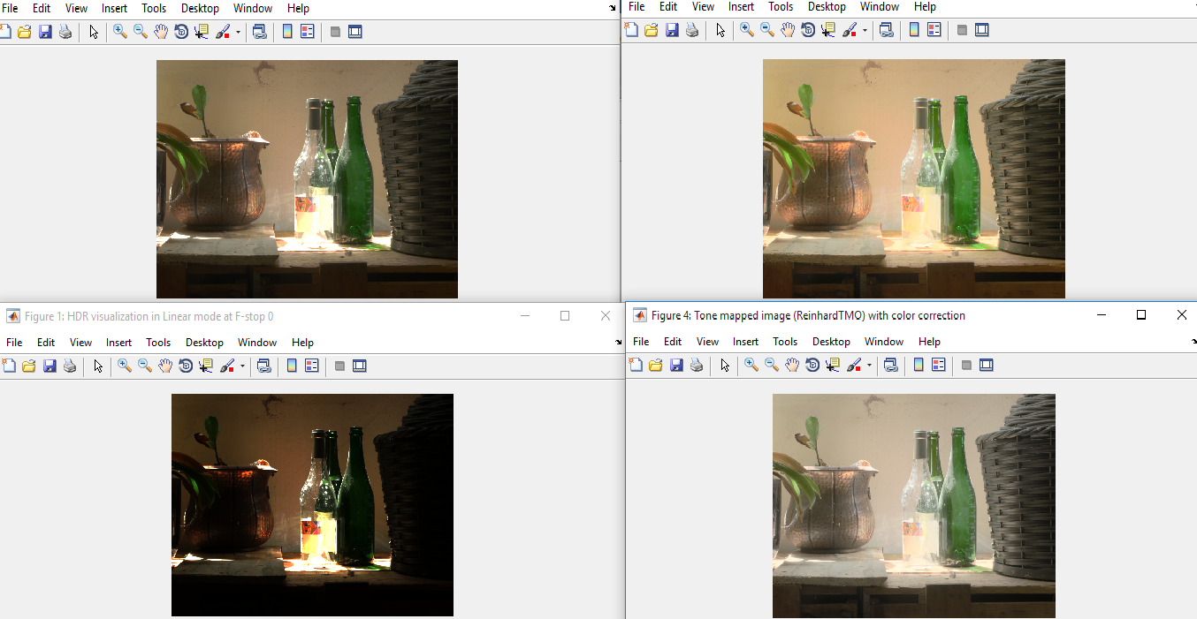
Experiments

Slide 35
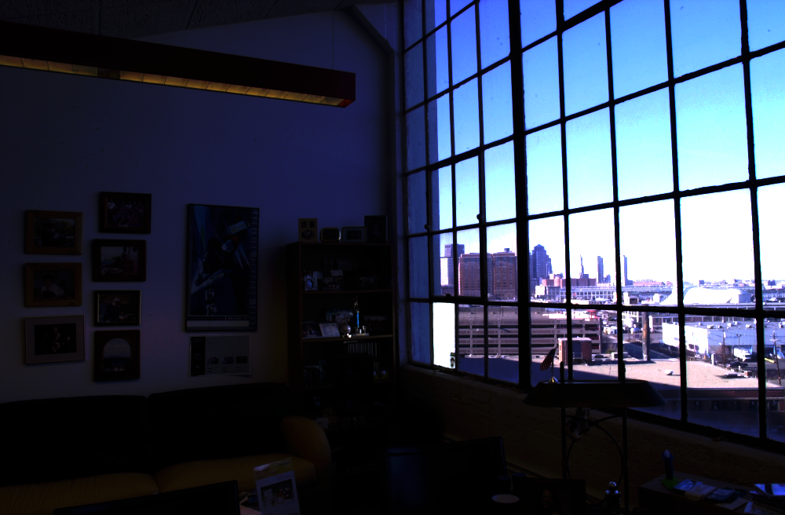
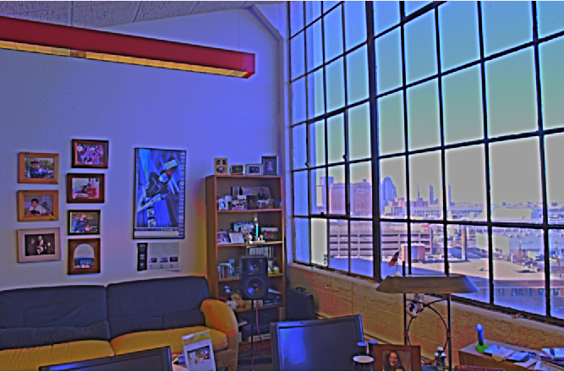
Experiments (Continue)

Slide 36
5. References

Slide 37
References
Mantiuk, Rafal, et al. "High dynamic range image and video compression-fidelity matching human visual performance." 2007 IEEE International Conference on Image Processing. Vol. 1. IEEE, 2007.
J. Baby and V. Karunakaran, “Survey On Various Image Contrast Enhancement Techniques”, International Journal For Research in Applied Science and Engineering Technology(IJRASE T), vol. 1 no. V, (2013) December, pp. 65-69.
Yeganeh, Hojatollah, and Zhou Wang. "High dynamic range image tone mapping by maximizing a structural fidelity measure." 2013 IEEE International Conference on Acoustics, Speech and Signal Processing. IEEE, 2013.
Ma, Kede, et al. "High dynamic range image compression by optimizing tone mapped image quality index." IEEE Transactions on Image Processing 24.10 (2015): 3086-3097.
Sujatha Ka , Dr D Shalini Punithavathanib.” Local and global tone mapping operators in hdr image processing with amalgam technique.” Sujatha et al., International Journal of Advanced Engineering Technology
Mansoor, Atif, and Adeel Anwar. "Subjective evaluation of image quality measures for white noise distorted images." Advanced Concepts for Intelligent Vision Systems. Springer Berlin/Heidelberg, 2010.

Slide 38
Questions??

